Slide 1
HTML Forms

Slide 2
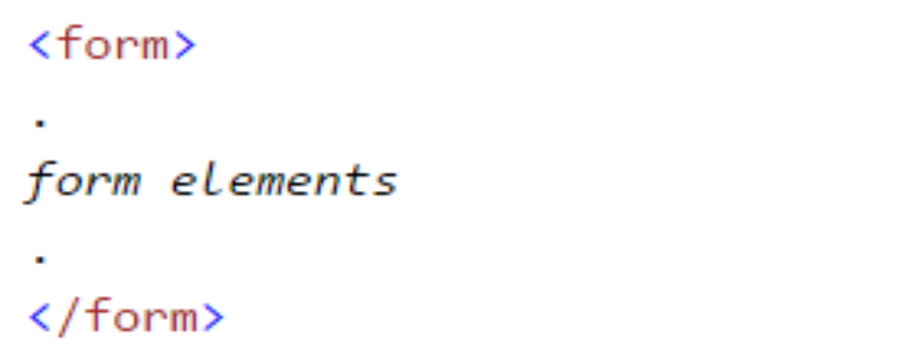
The <form> Element
HTML forms are used to collect user input.
The <form> element defines an HTML form:

Slide 3
HTML forms contain form elements.
Form elements are different types of input elements, checkboxes, radio buttons, submit buttons, and more.

Slide 4
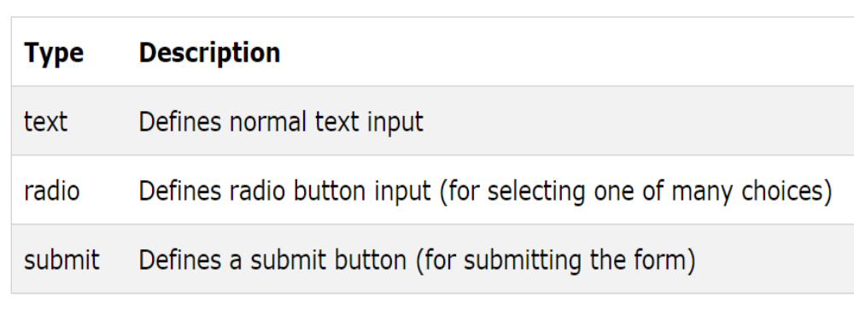
The <input> Element
The <input> element is the most important form element.
The <input> element has many variations, depending on the type attribute.
Here are the types used in this chapter:

Slide 5
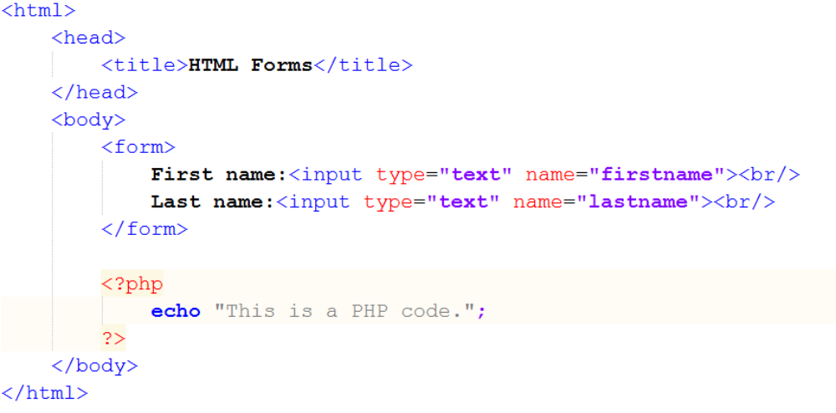
Text Input
<input type="text"> defines a one-line input field for text input:

Slide 6
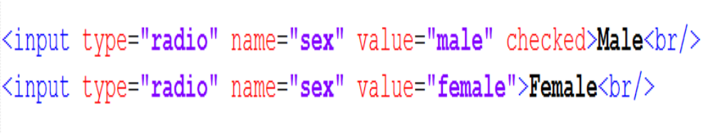
Radio Button Input
<input type="radio"> defines a radio button.
Radio buttons let a user select ONE of a limited number of choices:

Slide 7
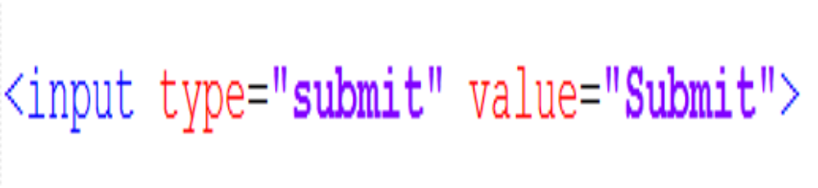
The Submit Button
<input type="submit"> defines a button for submitting a form to a form-handler.
The form-handler is typically a server page with a script for processing input data.
The form-handler is specified in the form's action attribute:

Slide 8
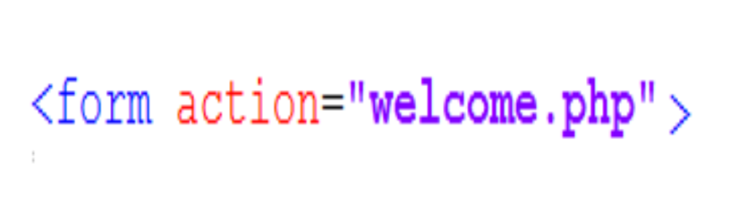
The Action Attribute
The action attribute defines the action to be performed when the form is submitted.
The common way to submit a form to a server, is by using a submit button.
Normally, the form is submitted to a web page on a web server.
In the example above, a server-side script is specified to handle the submitted form:

Slide 9
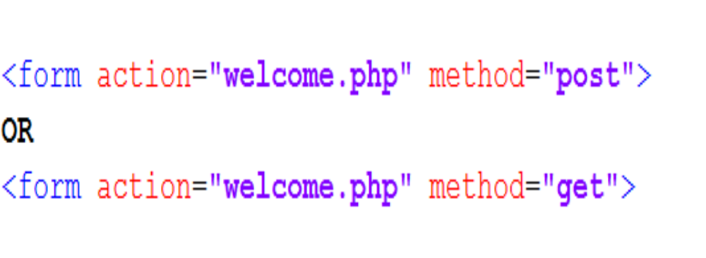
The Method Attribute
The method attribute specifies the HTTP method (GET or POST) to be used when submitting the forms:

Slide 10
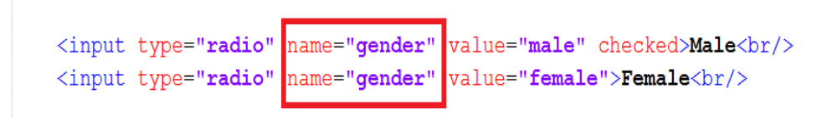
The Name Attribute
To be submitted correctly, each input field must have a name attribute.
This example will only submit the "Last name" input field:

Slide 11
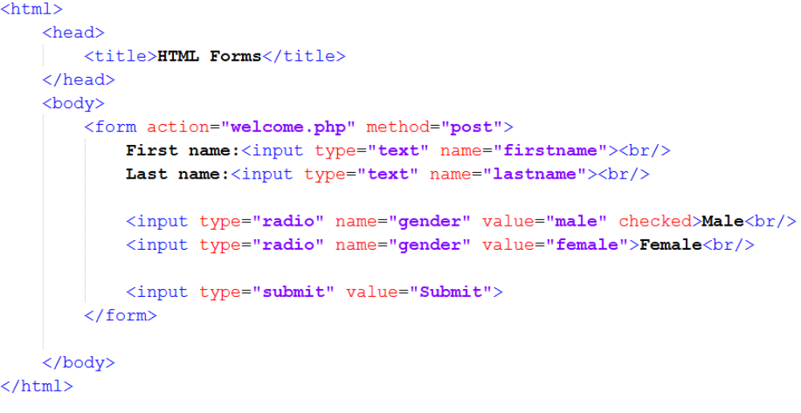
Example:

Slide 12
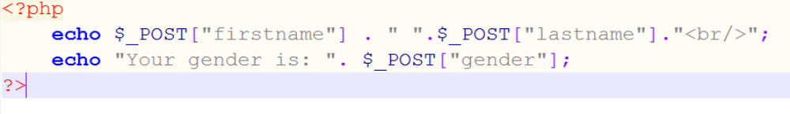
welcome.php

